Slide 1
Categorical Analysis of Restaurants in LA Downtown and their Online Delivery System
Roopashree Bhat

Slide 2
Background and Objective
Due to increasing population, traffic and drastic increase in demand for online food delivery both commercial as well as residential areas, the focus of this project is:
To analyze all restaurant venues and extract their major delivery providers if any, to get information on major competitors and other potential information which may be beneficial for future deliver providers
To analyze and categorize different cuisines which might provide valuable input for online delivery providers and to new startups planning to open new restaurants

Slide 3
Data Acquisition
Geo spatial data of Los Angeles county was provided by datasets of LA county in this link http://boundaries.latimes.com/set/la-county-neighborhoods-v5/ in form a JSON file
JSON file was extracted and converted into Data frame Information such as region, Neighborhood and their respective coordinates was extracted
Dataframe is further filtered to get data corresponding to central-LA region and within this only 4 main Downtown Neighborhoods namely Chinatown, Downtown, Pico-Union, Westlake are chosen
Foursquare location API was used to process the above neighborhoods to get various restaurant venues. The obtained JSON response was processed to get delivery provider information and cuisine category

Slide 4
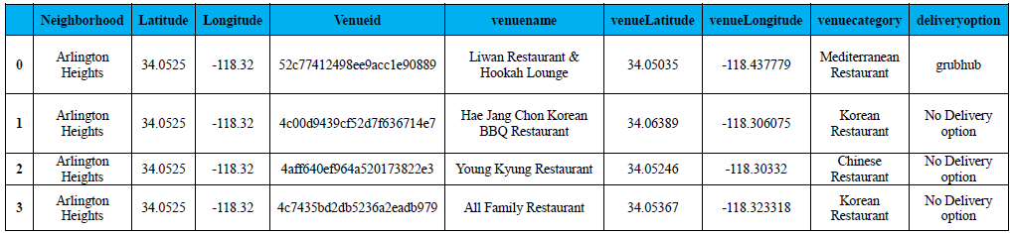
Dataframe Structure (Sample)

Slide 5
Preprocessing and Data Analysis
All column data is checked for Null values and irreverent data is dropped
Categorical data is converted into numeric using one-hot encoding
Restaurant Categories are grouped and analyzed with respect to total count of venues
Delivery Provider option within each neighborhood is also grouped and analyzed

Slide 6
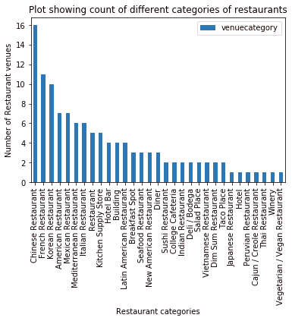
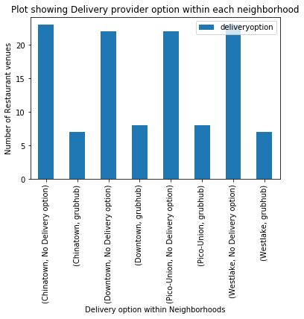
Data Analysis Bar Plot

Slide 7
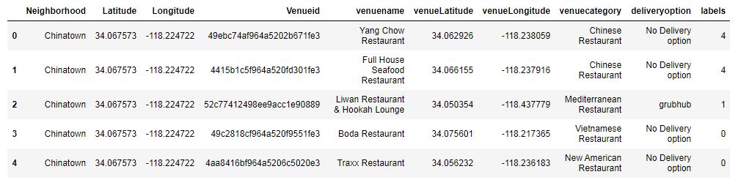
Clustering of Restaurants
K-Means clustering was employed to cluster into 10 clusters
Merged Dataframe including Cluster labels

Slide 8
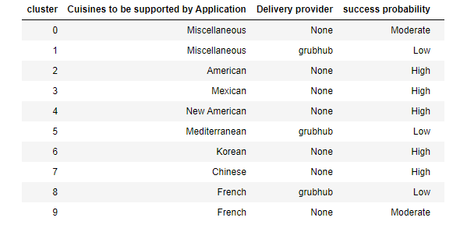
Results and Discussions
Properties of clusters and its future potential is summarized below

Slide 9
Conclusion
To start a new delivery provider service to current restaurants, Chinese, Korean, American and Mexican restaurants will prove to be highly beneficial due to their large numbers and due to lack of any current major delivery provider competitors
French Restaurants will be moderately beneficial as some French restaurants are already using grubhub service provider and the rest may follow them too
Cluster 0 corresponding to miscellaneous cuisines may be profitable as they don’t have current delivery provider but might be challenging as multiple cuisines need to be supported
Cluster 1 restaurants will be least profitable as they have existing provider and also complex due to multiple categories
From perspective of providing new cuisines / specialties in the location Chinese / Korean / French / Mexican / American may not be beneficial as they are already present in large numbers. Indian, Japanese, Peruvian, Vietnamese are in very few numbers. Starting these cuisines may be beneficial

